Slide 1
Analysing the Impact of Slow Wave and Spindle Coupling on Memory Consolidation During Sleep
By: Ananya Kulkarni (MSc. INFOTECH)
Supervisors: Samuel Morgan, Anna Wick (External)
Examiner: Prof. Dr. Pflüger
Institute for Parallel and Distributed Systems, University of Stuttgart

Slide 2






Slide 3
EEG and Sleep Overview
Electroencephalography (EEG) records brain activity via electrodes.
EEG in Sleep Science: Tracks oscillatory patterns, spindles during sleep.
Key Sleep Features:
Slow Oscillations (SOs)
Sleep Spindles
Coupling of SOs and Spindles
Notes:
Dataset still not divers
O eye blinks in sleep
Neutral memories are not semantic

Slide 4
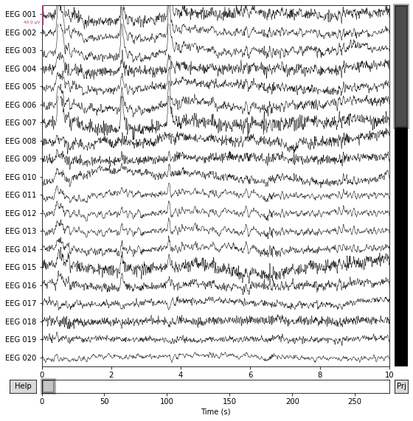
Notes:
Oscillatory brain wave patterns
This is an EEG output showing multiple channels of brain activity recorded over time. Each line represents the electrical activity measured from a specific electrode placed on the scalp.

Slide 5
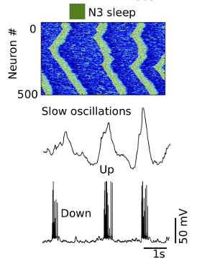
Slow Oscillations (SOs)
Low-frequency, high-amplitude
waves in deep sleep.
Happens during SWS.
Short-term to long-term storage.
Notes:
Slow Oscillations (SOs):
Happen during deep sleep (slow-wave sleep).
Help move memories from short-term to long-term storage. Diagram:
Heatmap: Green bands indicate neuronal activity ‘up states’ and blu regions indicate ‘down states’
These up and down transitions that are a hallmark of SOs
Middle panel: EEG recording of slow oscillations. These are characterized by a slow rhythm with distinct peaks and troughs
Bottom panel: The spikes during the 'up' state represent neuronal activity, while the flatline during the 'down' state indicates reduced neuronal firing."

Slide 6
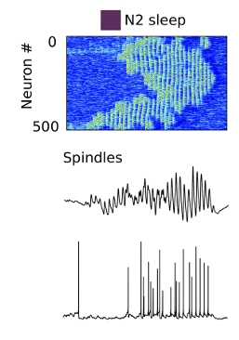
Sleep Spindles
Short bursts of faster oscillatory activity
Linked to information transfer and integration.
Notes:
Sleep Spindles:
Short bursts of brain waves during lighter sleep stages.
Help the brain process and organize information.
Heatmap: represents clusters of neuronal firing during spindles
The green regions reflect increased neuronal activity during the spindle bursts and blue is lower activity
Middle panel: spindles in eeg and it is with faster frequency compared to the slow oscillations Bottom panel: cellular activity underlying spindles. The spikes correspond to synchronized neuronal firing during the spindle events

Slide 7
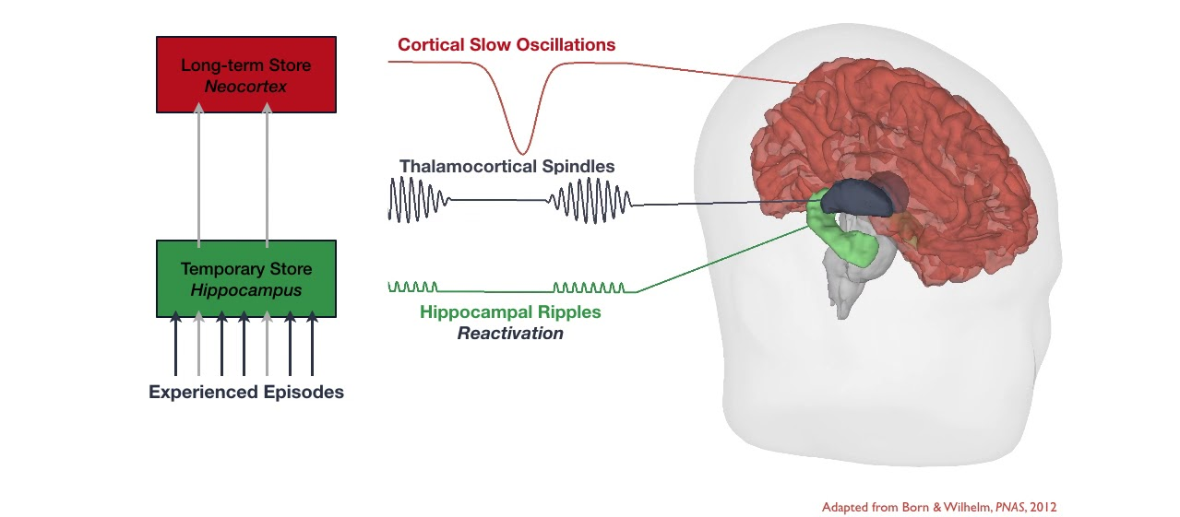
Coupling of Sos and Sleep Spindles
Hippocampus: Encodes and retrieves memories.
Cortex: Stores and organizes long-term memories.
Facilitates communication between the cortex and hippocampus
Strengthens memory networks.
Notes:
Coupling of SOs and Spindles:
SOs provide a time window for spindles to work efficiently.
Together, they connect the hippocampus (memory center) with the cortex (long-term storage).
This teamwork strengthens and stabilizes memories.
Diagram:
Memory consolidation
First, on the left side, we see the two key memory stores:
The Hippocampus (in green) acts as a temporary store for newly experienced information, such as events or episodes from the day.
The Neocortex (in red) is the long-term storage area, where memories are stabilized and become independent of the hippocampus over time.
Now, let’s look at how this transfer happens during sleep
The red waves represent cortical slow oscillations setting the rhythm.
The black oscillations represent spindles enhancing communication.
The green ripples represent hippocampal reactivation and replay of memory traces.

Slide 8
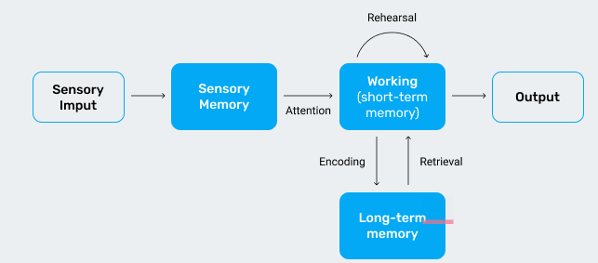
Memory Process Overview
Ananya Kulkarni 9
Notes:
illustrates the flow of information in the memory system, highlighting how sensory input is processed and stored. Let’s break it down step by step:
Sensory Input and Sensory Memory
It all starts with sensory input from the environment—things we see, hear, or feel.
This information is briefly held in sensory memory, a very short-term storage that lasts only a few milliseconds to a couple of seconds.
Attention and Working Memory (Short-Term Memory)
When we pay attention to specific sensory information, it moves into working memory, also known as short-term memory.
This is where active processing happens—like holding a phone number in your head for a few seconds.
Information here is temporary unless we actively work on it through rehearsal, such as repeating it to ourselves, which keeps it in working memory for longer.
Encoding into Long-Term Memory
From working memory, information can be encoded into long-term memory for more permanent storage.
Long-term memory has a much larger capacity and can store information for a lifetime, such as facts, skills, and experiences.
Retrieval and Output
When we need to use stored information, it is retrieved from long-term memory and brought back into working memory for processing.
This retrieved information, along with new inputs, is then used to produce an output, such as answering a question or making a decision.

Slide 9
Types of Memory Studied
Emotional (emotionally charged)
Neutral (semantic memories)
Procedural (skills like typing or tapping)
Notes:
Emotional memory tasks would instead involve recalling personal or emotionally charged content,
semantic memory examples like:
Recalling names of objects (e.g., chair, car).
Remembering facts or trivia (e.g., the capital of a country, a mathematical formula).
Procedural Memory is a type of long-term memory that involves remembering how to perform tasks or actions. It’s about "knowing how" rather than "knowing what

Slide 10
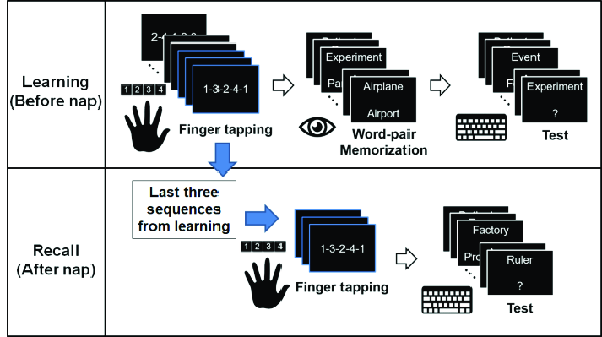
How it’s measured?
Picture recall
Finger tapping (procedural)
Memory
Consolidation

Slide 11
Introduction: Why Study Sleep and Memory?
Sleep is essential for memory consolidation and cognitive health.
Slow-wave sleep (SWS) features two key oscillations: Sos and Sleep Spindles
Coupling of SOs and spindles strengthens memory integration between:
This study examines how SO-spindle coupling impacts memory task performance.
Hippocampus
Cortex
Notes:
Hippocampus: Encodes and retrieves memories.
Cortex: Stores and organizes long-term memories.

Slide 12
Study Motivation
Explore correlations between SO-spindle coupling and performance on emotional, neutral, and procedural memory tasks.
Address gaps in understanding demographic factors (e.g., age, gender) on sleep-based memory processes.

Slide 13
Key Findings in Literature
Automated Detection
Algorithms for SO and spindle detection (e.g., SUMO, YASA) are commonly used in studies like Muehlroth et al.
Analyzing Coupling Metrics
Staresina highlights spindle-SO synchronization and precise coupling metrics..
Correlation with Memory Performance
Spindle-SO coupling correlates with memory and hippocampal connectivity
Notes:
Studies like “Muehlroth, B.E., Sander, M.C., Fandakova, Y. et al.” use algorithms for SO and spindle detection, closely aligned with tools (e.g., SUMO and YASA).
Papers such as “Bernhard P. Staresina" emphasize precise coupling metrics, focusing on synchronization and alignment of spindles with SO phases.
"Spindle–Slow Oscillation Coupling Correlates with Memory Performance" links coupling dynamics to hippocampal connectivity and memory outcomes, matching your statistical approach.

Slide 14
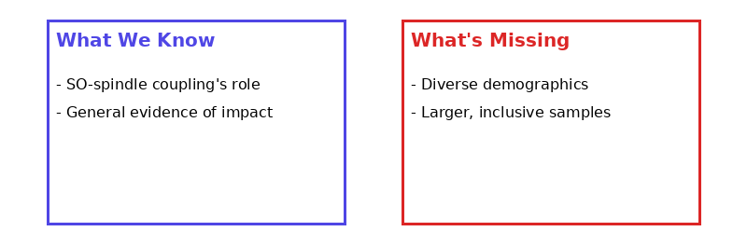
Research Gap
Limited exploration of demographic factors
Small sample sizes.
Notes:
Research has highlighted the role of slow oscillation (SO) and spindle coupling in memory consolidation and provided general evidence supporting its impact on learning and memory processes.
We lack an understanding of how these mechanisms might differ across diverse demographic groups, such as age ranges, cultural backgrounds, or individuals with different sleep patterns.

Slide 15
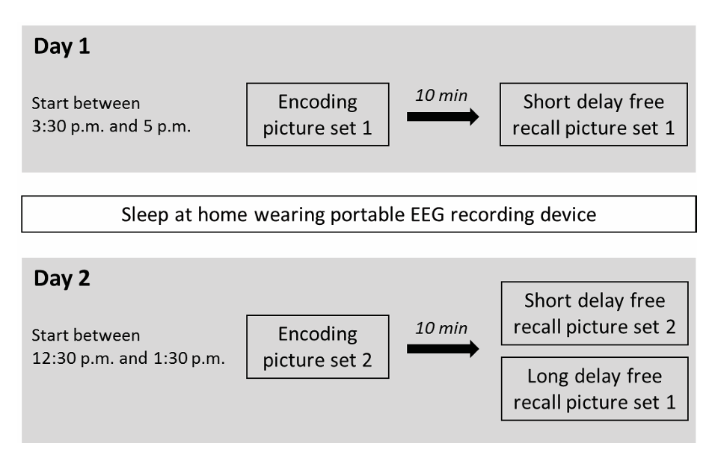
Dataset and Experimental Setup
4. (Ackermann, 2014)
~2000 participants across two experimental days.
Day 1 Tasks:
Emotional and neutral picture recall (Set 1).
Working memory task (n-back).
Procedural memory task (finger tapping).
Day 2 Tasks:
Recall of Set 1 and Set 2.
Repeat of n-back and finger-tapping tasks.
EEG Data:
4-channel EEG, EOG (eye movements), EMG (muscle activity).
Notes:
Addressing one of these gaps,

Slide 16
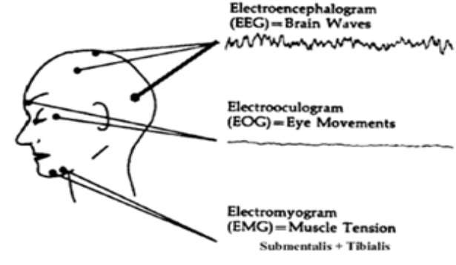
Location of EEG, EOG and EMG electrodes
Notes:
Sleep is determined by physiological changes in EEG (electroencephalogram – electrical signals from the brain), EMG (electromyogram – muscle movement), EOG (electrooculogram - eye movement) other variables including temperature, blood pressure and neuroendocrine function
4-Channel EEG: Records brain activity from four scalp locations.
EOG: Tracks eye movements during sleep stages.
EMG: Measures muscle activity to detect artifacts or confirm relaxation

Slide 17
Methodology
Preprocessing Data
Detect Slow Waves and Sleep Spindles
Defining Coupling Windows Around SOs
Visualize the Data
Statistical Methods
Analyzing Coupling Metrics

Slide 18
Planned Implementation
Data Preprocessing
Filter raw EEG data to focus on the relevant frequency ranges for sleep analysis.
Use Independent Component Analysis (ICA) to remove artifacts like eye blinks and muscle movements.
Detect SOs and Sleep Spindles
Apply algorithms such as YASA for slow oscillations (~0.5-1 Hz) and SUMO for sleep spindles (~12-16 Hz).
Mark events on the EEG timeline.
Define Coupling Windows
Identify slow oscillation peaks and create a ±1 second window to check for spindle alignment.
Analyze Metrics
Measure spindle density, SO amplitude, and synchronization between spindles and SOs.
Statistical Analysis
Correlate spindle-SO coupling metrics with memory performance across different tasks.
Accuracy or recall ability in Emotional/Neutral memory tasks
.

Slide 19
Conclusion
SO-spindle coupling is critical for memory consolidation
Automated EEG tools like YASA and SUMO for detecting and analyzing SO-spindle interactions.
This study advances our understanding of how coupling impacts task-specific memory performance.
Notes:
SO-spindle coupling during slow-wave sleep is critical for memory consolidation, bridging hippocampal encoding and cortical storage.
Automated EEG tools like YASA and SUMO provide reliable methods for detecting and analyzing SO-spindle interactions.
This study advances our understanding of how coupling impacts task-specific memory performance.

Slide 20
Future Direction
Extend Analyses
Explore coupling dynamics across all sleep stages.
Investigate how SOs and spindles evolve overnight.
Demographic Variability
Analyze effects of age, gender, and other demographic factors on coupling.
Memory and Cognition
Correlate SO-spindle coupling with working memory and procedural learning outcomes.

Slide 21
Applications / Implications
Therapeutic Strategies
Develop treatments for memory impairments by targeting SO-spindle coupling.
Sleep-Based Learning
Apply insights to improve education and skill acquisition.
Diagnostics
Enhance tools for early detection of sleep and neurodegenerative disorders.
Ananya Kulkarni 21

Slide 22
References / Sources
Muehlroth, B.E., Sander, M.C., Fandakova, Y. et al. Precise Slow Oscillation–Spindle Coupling Promotes Memory Consolidation in Younger and Older Adults. Sci Rep 9, 1940 (2019). https://doi.org/10.1038/s41598-018-36557-z
Michael A HahnDominik HeibManuel SchabusKerstin HoedlmoserRandolph F Helfrich (2020) Slow oscillation-spindle coupling predicts enhanced memory formation from childhood to adolescence eLife 9:e53730. https://doi.org/10.7554/eLife.53730
Lisa Bastian, Anumita Samanta, Demetrius Ribeiro de Paula, Frederik D. Weber, Robby Schoenfeld, Martin Dresler, Lisa Genzel - Spindle–slow oscillation coupling correlates with memory performance and connectivity changes in a hippocampal network after sleep (2022). https://doi.org/10.1002/hbm.25893
Sleep Research
Sandra Ackermann, Francina Hartmann, Andreas Papassotiropoulos, Dominique J.F. de Quervain, Björn Rasch, No Associations between Interindividual Differences in Sleep Parameters and Episodic Memory Consolidation, Sleep, Volume 38, Issue 6, 1 June 2015, Pages 951–959, https://doi.org/10.5665/sleep.4748

Slide 23

Thank You!
Ananya Kulkarni
MSc INFOTECH
e-mail: ananyakulkarni55@gmail.com
Phone: +49 17685982399
University of Stuttgart

